Slide 1
Web Application Development ISCG7420 Introduction to Web Development
School of Computing, Electrical and Applied Technology

Slide 2
Outlines – Django Rest-Framework
Serialization
ModelSerializers
Function based API View
API View Decorators
Class based API View
Mixins
Viewsets and Routers
Generic Viewsets
Model Viewsets

Slide 3
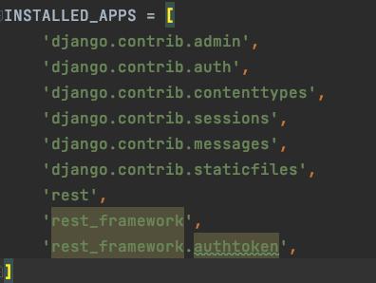
Preparation
New Project
New app
python manage.py startapp rest
pip install djangorestframework

Slide 4
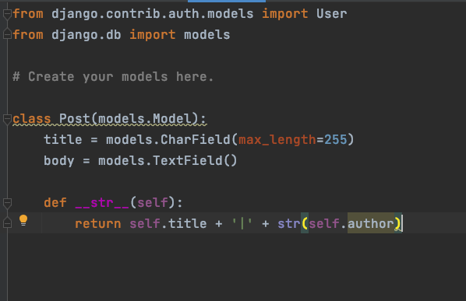
Preparation
Model Post

Slide 5
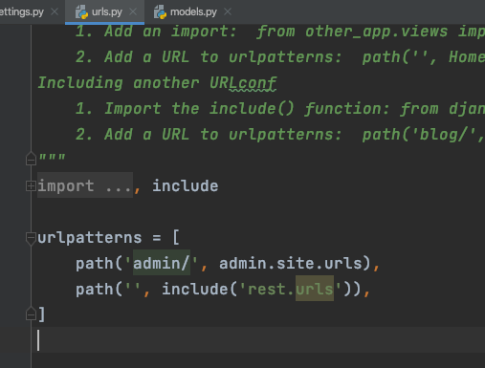
Preparation
Urls

Slide 6
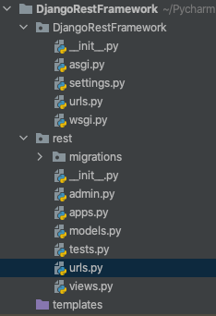
Preparation
Create a urls.py in rest folder

Slide 7
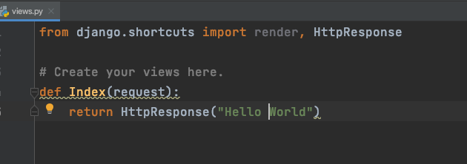
Create “hello world”
view.py

Slide 8
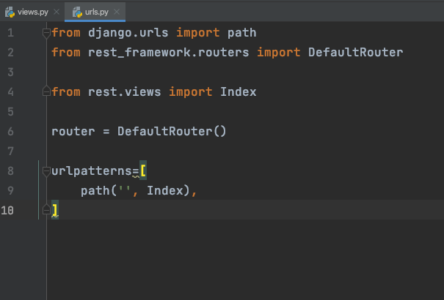
urls

Slide 9
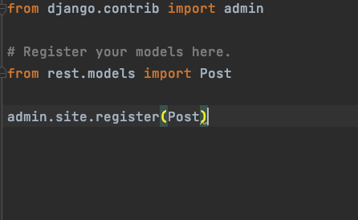
Register model to admin

Slide 10
Ready to go
makemigrations
migrate
createsuperuser
runserver

Slide 11
serializers
https://www.django-rest-framework.org/api-guide/serializers/
https://www.django-rest-framework.org/tutorial/1-serialization/

Slide 12
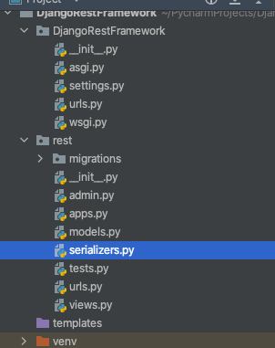
Create a serializer file

Slide 13
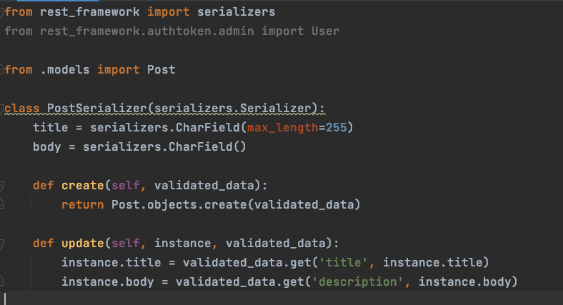
serializer class

Slide 14
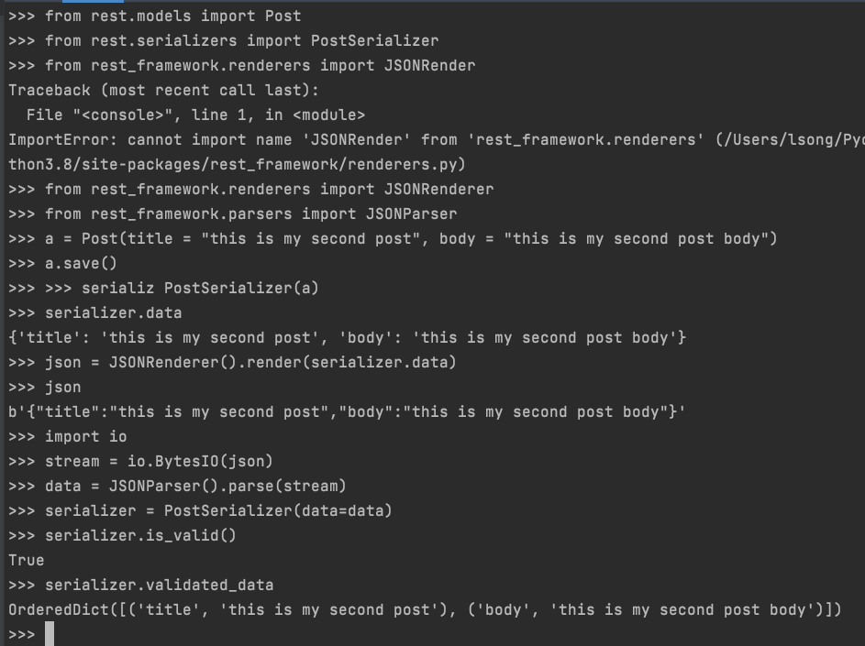
Test your serializer

Slide 15
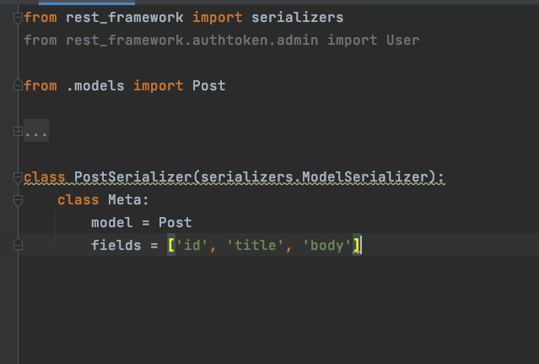
ModelSerializer

Slide 16
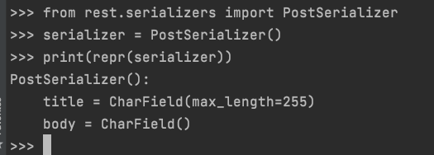
Test your serializer

Slide 17
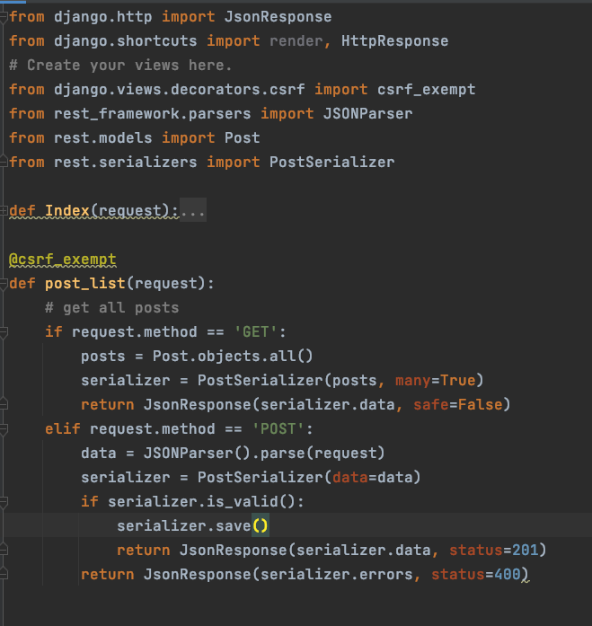
View
@csrf_exempt → Working with AJAX, CSRF & CORS

Slide 18
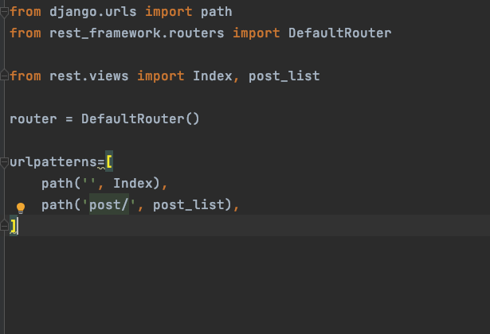
urls

Slide 19
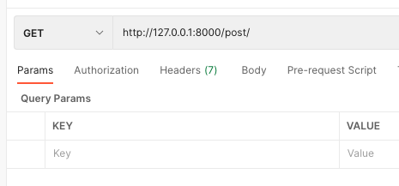
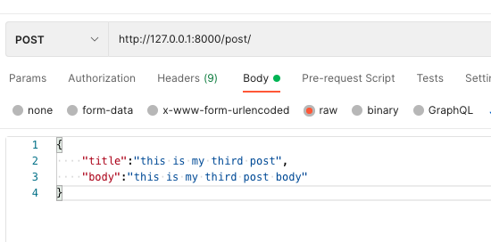
Postman
Create a new collection
Create a new request

Slide 20
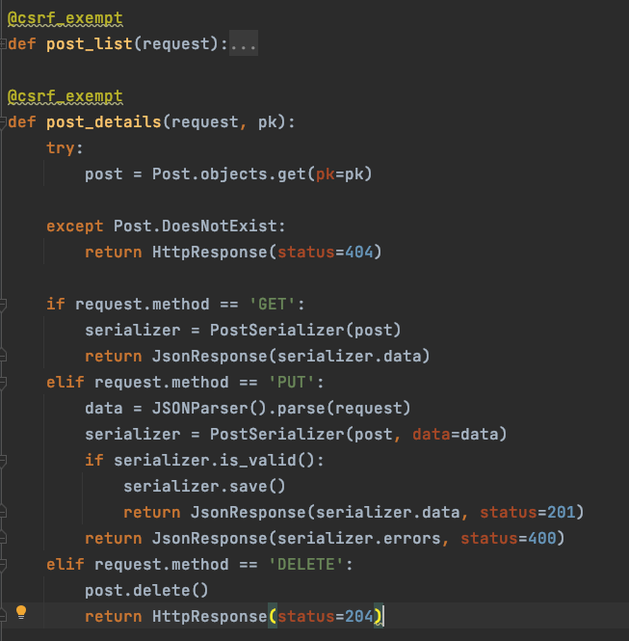
Single object

Slide 21
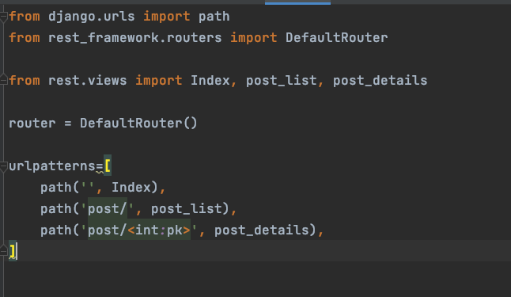
View file

Slide 22
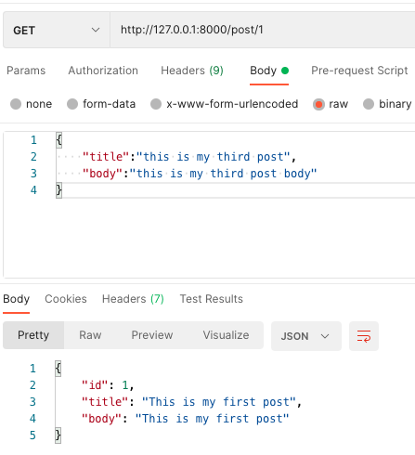
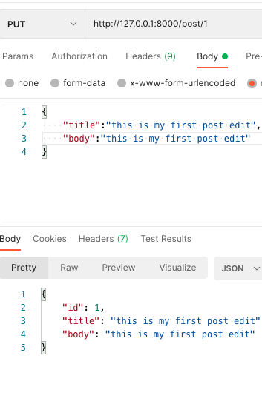
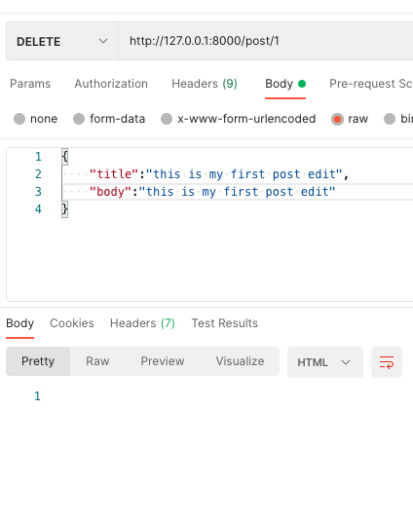
Postman
http://127.0.0.1:8000/post/1

Slide 24
API View Decorators
https://www.django-rest-framework.org/tutorial/2-requests-and-responses/
Requests
Responses

Slide 25
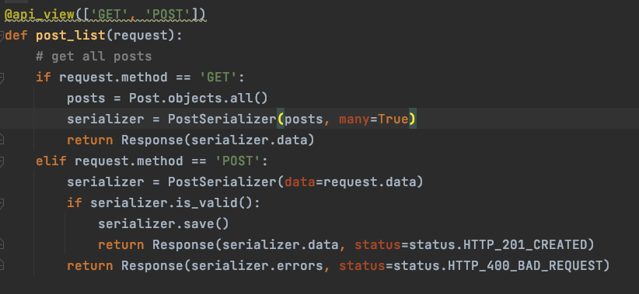
Api view

Slide 26
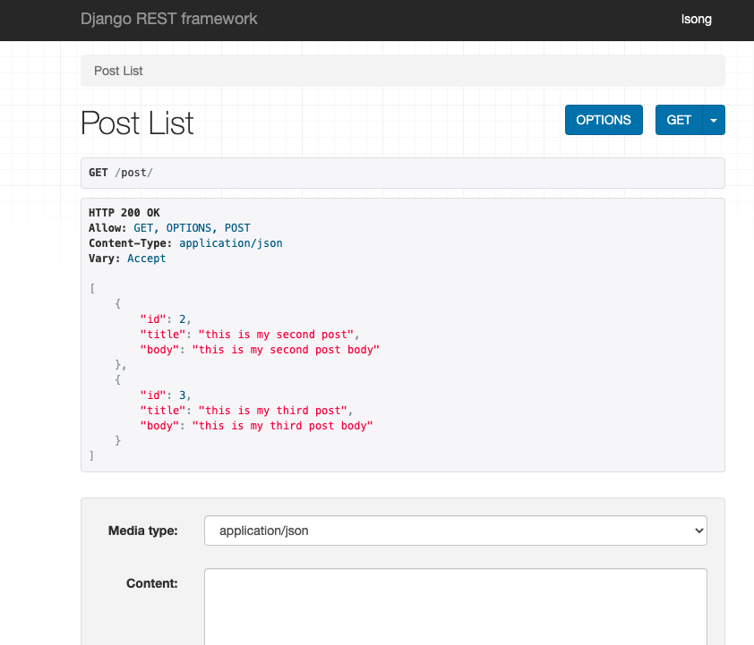
On your page

Slide 27
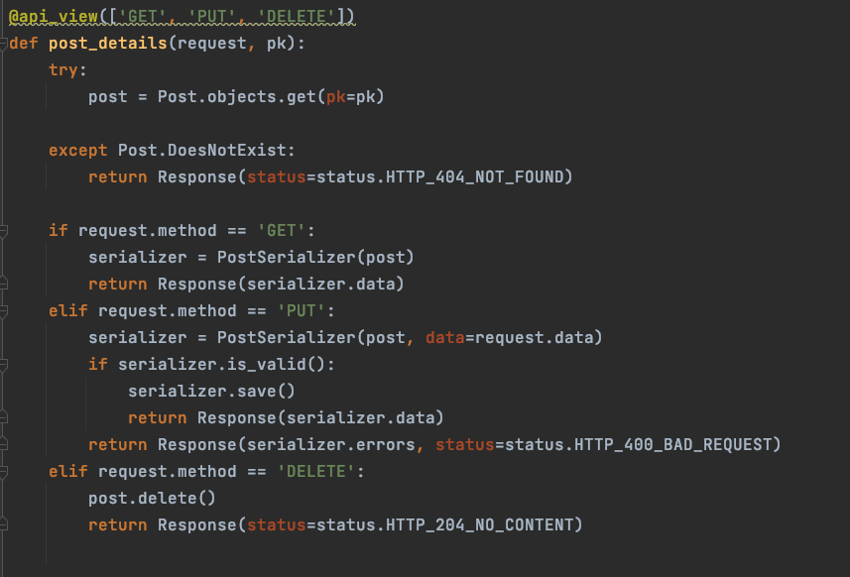
For single object

Slide 28
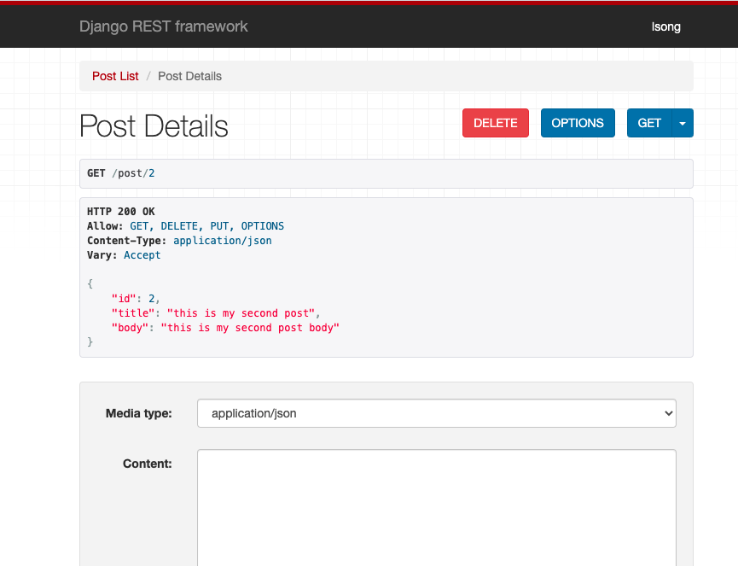
On your page

Slide 29
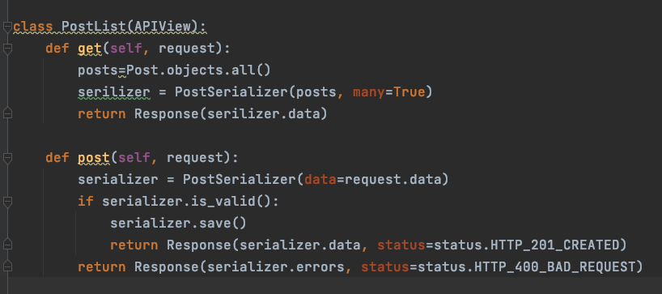
Class based API View
https://www.django-rest-framework.org/tutorial/3-class-based-views/

Slide 30
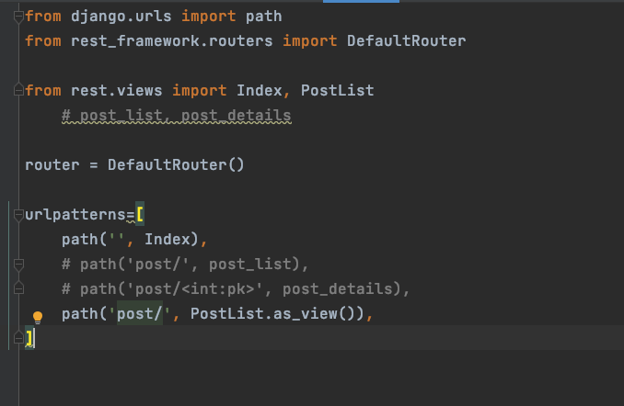
urls
Check on your page please

Slide 31
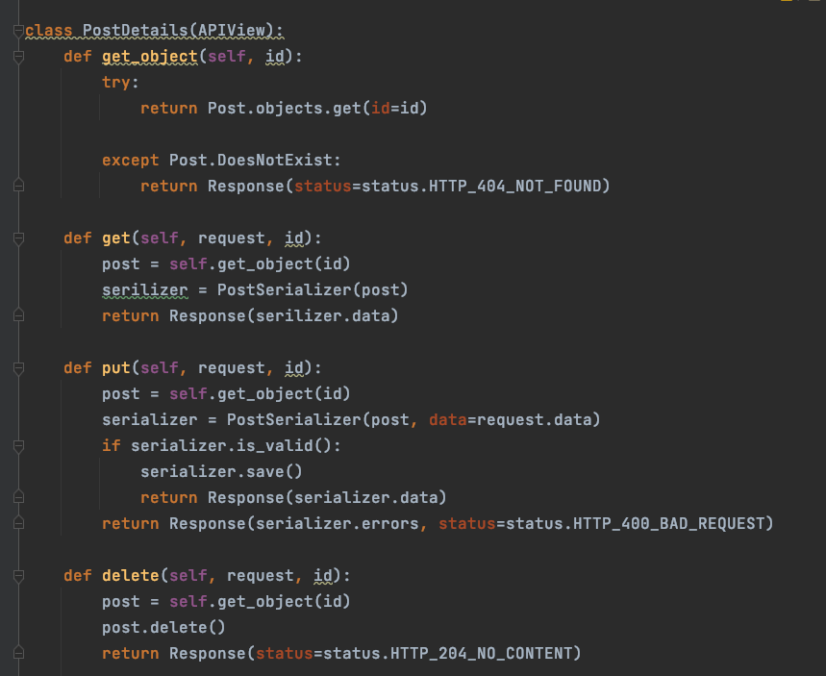
Single objects

Slide 32
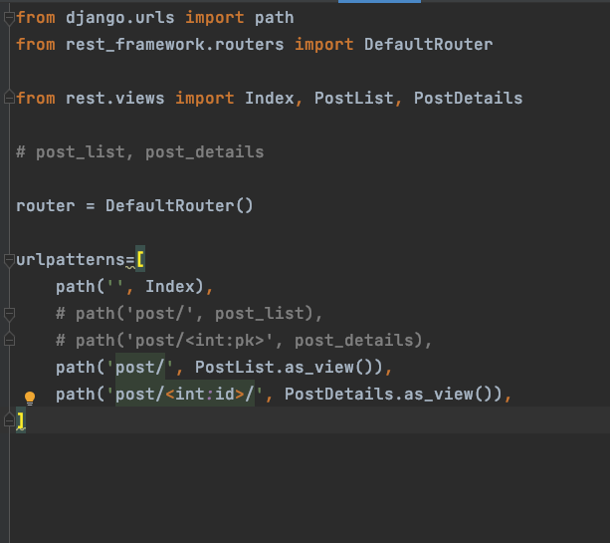
urls
Check on your page please

Slide 33
Mixins
https://www.django-rest-framework.org/tutorial/3-class-based-views/#using-mixins
List
Create
Retrieve
Update
Destroy

Slide 34
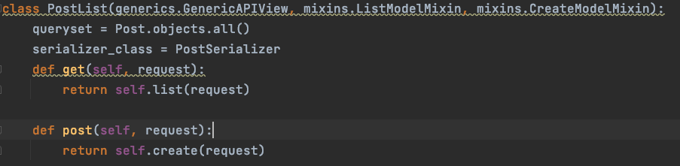
Class mixins
ListModelMixin
CreateModelMixin

Slide 35
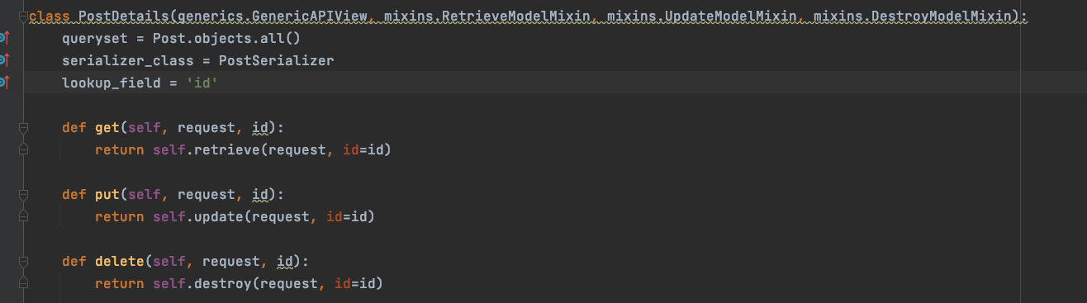
Class mixins – cont’d
RetrieveModelMixin
UpdateModelMixin
DestroyModelMixin

Slide 36
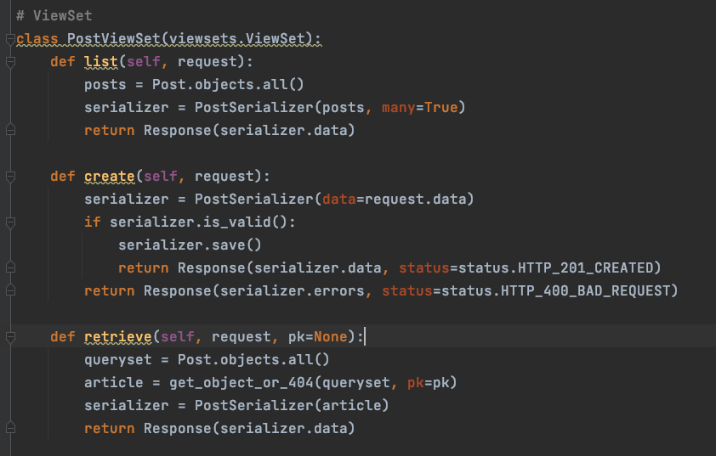
Viewsets and Routers
https://www.django-rest-framework.org/tutorial/6-viewsets-and-routers/

Slide 37
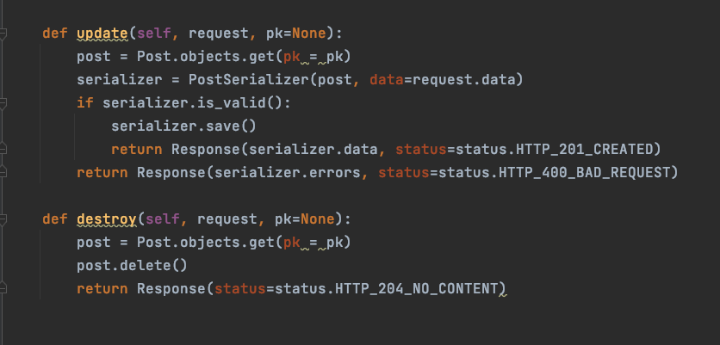
Viewsets and Routers

Slide 38
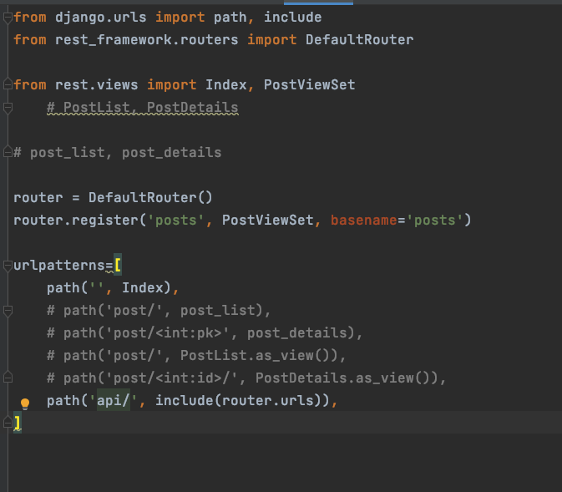
DefaultRouter

Slide 39
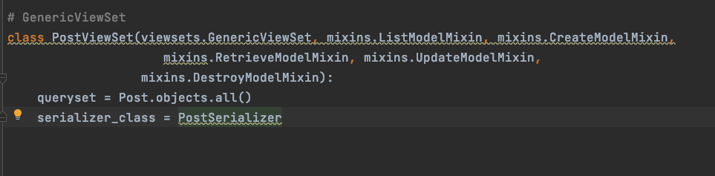
Generic Viewsets
https://www.django-rest-framework.org/api-guide/viewsets/#genericviewset

Slide 40
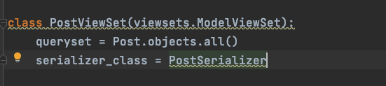
Model Viewsets

Slide 41
Source
https://www.youtube.com/watch?v=VBqJ0-imSMU&ab_channel=ParwizForogh

